Slide 1
FUNCTIONS AND
PIGEON HOLE PRINCIPLE

Slide 2
SYLLABUS
Definition and types of functions: Injective, Surjective and Bijective
Composition, Identity and Inverse
Pigeon-hole principle , Extended Pigeon-hole principle
2

Slide 3
DEFINITION OF FUNCTIONS
Let A and B be non–empty sets. A function ƒ from A to B, denoted as f : A → B, is a relation from A to B such that for every a ∈ A, there exists a unique b ∈ B such that (a, b) ∈ f.
Normally if (a, b) ∈ f, we write f (a) = b
An important point to be re-emphasised is that ƒ is
a relation with the following special property :
If
f (a) = b
then,
and f (a) = c
b = c
This condition implies that to each element a ∈A, a unique element b ∈ Β should be assigned by the relation f.
3

Slide 4
GENERIC FUNCTIONS
A function f: X → Y is a relationship between elements of X to elements of Y, when each element from X is related to a unique element from Y
X is called domain of f, range of f is a subset of Y so that for each element y of this subset there exists an element x from X such that y = f(x)
Sample functions:
f : R → R, f(x) = x²
f : Z → Z, f(x) = x + 1
f : Q → Z, f(x) = 2
4

Slide 5
GRAPHICAL REPRESENTATIONS
Functions can be represented graphically in several ways:
f f
A
B
•
•
•
•
•
•
•
•
•
•
•
y
a
b
x
Plot
A
B
Graph
Like Venn diagrams
5

Slide 6
SOME FUNCTION TERMINOLOGY
If f:A→B, and f(a)=b (where a∈A & b∈B), then:
A is the domain of f.
B is the codomain of f.
b is the image of a under f.
a is a pre-image of b under f.
In general, b may have more than one pre-image.
The range R⊆B of f is {b | ∃a f(a)=b }.
5

Slide 7
Example 1
f = {(-3,1),(0,2),(2,4)}
Domain Range
-3
1
2
FUNCTION 0
One-to-One
2
4
{(-1,5),(1,3),(4,5)}
{(5,6),(-3,0),(1,1),(-3,6)}
Domain Range
-1
Domain Range
-3
0
1
6
1
4
3
5
1
5
7
FUNCTION
Not a Function

Slide 8
Example 2: following :
(i)
(iii) Solution:
If f is the mod - 12 function, compute each of the
f (1259 + 743) (ii)
f (2.319) (iv)
f (1259) + f (743)
2 · f (319)
(i) f (1259 + 743) =
= (ii) f (1259) + f (743) =
=
=
=
=
=
=
f (2002)
2002 ÷ 12 = 10
1259 ÷ 12 + 743 ÷ 12
11 + 11
22
2.319 ÷ 12 2.319
2 × 319 ÷ 12 = 2 × 7
14
(iii)
f (2.319)
(iv)
2 · f (319)

Slide 9
Example 3
Given f(x) = 3x – 5 and g(x) = x² + 2, find:
(a) f(-3)
f(x) = 3x – 5
f(-3) = 3(-3) – 5
= -9 – 5 = -14
(b) g(2z)
g(x) = x² + 2
g(2z) = (2z)² + 2
= (2)²(z)² + 2
= 4z² + 2

Slide 10
TYPES OF FUNCTIONS
One to One (Injective )
Onto (Surjective)
One to One Onto Function (Bijective)

Slide 11
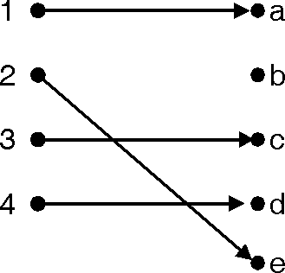
ONE-TO-ONE FUNCTIONS
Function f : X → Y is called one-to-one (injective) when for all elements x1 and x2 from X if f(x1) = f(x2), then x1 = x2
Iff every element of its range has only one pre- image. Only one element of the domain is mapped to any given one element of the range.
Example : Let A = { 1, 2, 3, 4 }, and B = { a, b , c,
d, e }.
and f = {(1, a), (2, e), (3, c), (4, d)}.
f (1) = a
f (3) = c
f (2) = e
f (4) = d
Given function ƒ is one to one or injective function.
11

Slide 12
ONE-TO-ONE ILLUSTRATION
Graph representations of functions that are (or not) one-to-one:
•
•
•
•
•
•
•
•
•
•
•
•
•
•
•
•
•
•
•
•
•
•
•
•
•
•
•
Not one-to-one
Not even a function!
One-to-one
12

Slide 13
Let A = {1, 2, 3} and B = {a, b, c, d}. Which of the following is a one-to-one function?
Choices:
A. {1,a 2,c, 3,a}
B. {1,b 2,d 3,a}
C. {1,a, 2,a, 3,a}
D. {1,c 2,b 1,a, 3,d}
Correct Answer: B
13

Slide 14
ONTO FUNCTIONS
Function f : X → Y is called onto (surjective) when given any element y from Y, there exists x in X so that f(x) = y
Determine whether the following functions is onto: Example : Let A = { 1, 2, 3, 4 } and B = { a, b, c, d}.
and f = {( 1, a), (2, d), (4, c), (3, b)}. f (1) = a, f (2) = d, f (3) = b, f (4) = c,
Ran (ƒ) = { a, b, c, d } = B.
So this function is onto or surjective function.
14

Slide 15
ILLUSTRATION OF ONTO
Some functions that are or are not onto their codomains:
•
•
•
•
•
•
•
•
•
•
• •
• •
• •
• •
• •
• •
• •
•
• •
• •
• •
• •
•
Onto
Not Onto
(or 1-1)
Both 1-1
and onto
1-1 but
not onto
(but not 1-1)
15

Slide 16
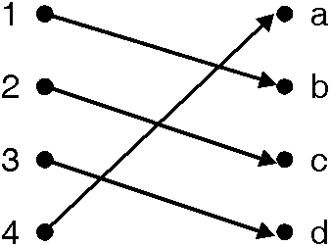
ONE TO ONE ONTO(BIJECTIVE) FUNCTIONS
Function from A to B is said to be one to one onto (bijective) if it is both one to one and onto function
Determine whether the following functions is bijective:
Example : Let A = { 1, 2, 3, 4 }, B = { a, b, c, d }.
and f = {(1, b), (2, c), (3, d), (4, a)}.
f(1) = b,
f(3) = d,
f(2) = c,
f(4) = a.
Given function ƒ is one to one onto or
bijective function.
16

Slide 17
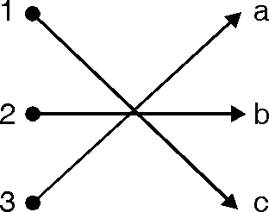
EVERYWHERE DEFINED FUNCTION
A function f is said to be everywhere defined if Dom( f) = A
Example : Let A = {1, 2, 3 }, B = { a, b, c }.
and f = {(1, c ), (2, b), (3, a)}. f (1) = c, f (2) = b,
f (3) = a.
Dom (f) = { 1, 2, 3 }. Thus given function f is everywhere defined function.
17

Slide 18
PROBLEMS
Q1 : Is the following function one to one ? f : Z → Z, where f (x) = 2x – 1.
Soln. :
Let,
a, b, ∈ Z and if f (a) = f (b) then
2a – 1
a =
= 2b – 1.
b.
∴ f is one to one function
Q 2 : Is the following function one to one ? g : Z → Z where g (x) = x².
Soln. : g( – 2) = g (2) = 4.
Two numbers are giving same output so above function is not one to one.
18

Slide 19
Q 3 : Let A = { 0, – 1, 1 } and B = { 0, 1} Let f : A → B
where f(a) = |a| . Is f onto?
Soln. :
The elements of B are 0 and 1.
Hence f is onto if we can find x, y ∈ A such that f(x) = 0
and f(y) = 1.
Now, f(0) = |0| = 0 and f(– 1) = | – 1| = 1.
Hence to each element b of B there is an element
a ∈ A.
∴ f(a) = b. Hence f is onto
19

Slide 20
Q 4 : Let A = B = Z and let f : A → B be defined by
f(a) = a + 1, for a ∈ A. Which of the special properties does f possess?
Soln. :
Since the formula defining f makes sense for all integers,
Dom (f) = Z = A
and so f is everywhere defined Suppose that
f(a) =
a + 1 =
a =
f(a′) for a, a′ ∈ A then a′ + 1
a′ Hence f is one to one
So
To see if f is onto, Let b be an arbitrary element of B. Can we find an element a ∈ A such that f(a) = b?
Since f(a) = a + 1 we need an element a in A such that
a + 1 =
of course, a
b
= b – 1
will satisfy the desired equation. Since b – 1 is in A. Hence Ran (f) = B; therefore f is onto.
20

Slide 21

Q 5.: Let A = B = R, the set of real numbers.
Let f : A → B be given by the formula f(x) = 2x³ – 1
Let g : B → A be given by
Show that f is bijection between. A and B and g is a bijection between B and A.
Soln. :
A function from A to B is Bijection if it is one to one and onto
∴ for f(x) =2x³ – 1 to be one to one and onto.
If a, b, ∈ A
Such that f(a) =
⇒
f(b) 2b³ – 1
b
2a³ – 1 =
a =
∴ f is one to one

Slide 22
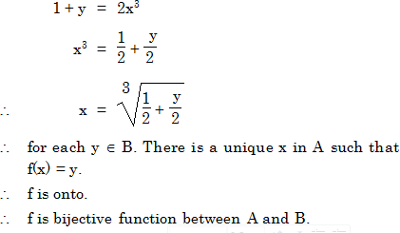
y =2x³ – 1
Now for

Slide 23
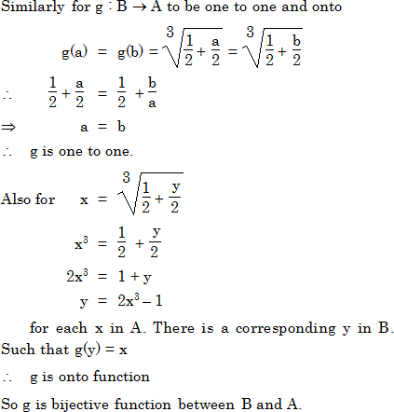

Slide 24
COMPOSITION OF FUNCTIONS
Let f be a function from A to B (i.e. f : A → B) and g be a function from B to C (i.e. g : B → C). Then the composition of f and g denoted as “g o f ” is a relation from A to C, where g o f (a) = g (f (a)).
g o f : A → C is also a function.
Composition of two one-to-one functions is one-to-one
Composition of two onto functions is onto

Slide 25
PROBLEMS
Q.1 :
Let A = { 1, 2, 3 }, B = { a, b } and C = { 5, 6, 7 }.
Let f : A → B be
defined by f(1) = a. f(2) = a.
i.e. f = {(1, a), (2, a), (3, b)}.
Let g : B → C be defined by
f(3) = b.
g(a) = 5 g(b) = 7 i.e. g = {(a, 5), (b, 7)}.
Find composition of f and g i.e. (g o f)
Soln. :
If If If
f(1) =a and g(a) = 5 then g o f (1) = 5 f(2) =a and g(a) = 5 then g o f (2) = 5 f(3) =b and g(b) = 7 then g o f (3) = 7
i.e. (g o f) (1) =5
(g o f) (2) =5
(g o f) (3) =7
g o f = {(1, 5), (2, 5), (3, 7)}.
25

Slide 26
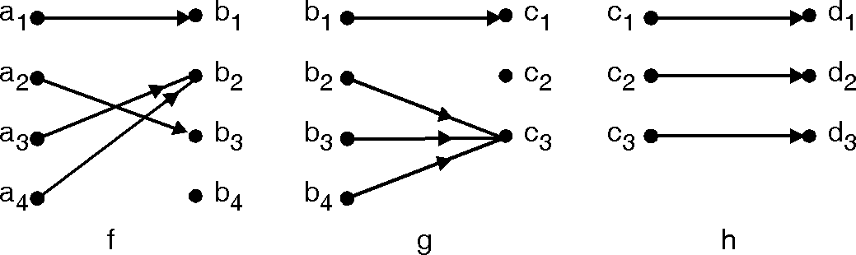
PROBLEMS
Q. 2 : A = { a₁, a₂, a₃, a₄ },
B = { b₁, b₂, b₃, b₄ },
C = {c₁, c₂, c₃}, D = { d₁, d₂, d₃ }.
For the function f and g, determine g o f.
For the function f, g and h, determine h o (g o f ) and (h o g) o f

Slide 27
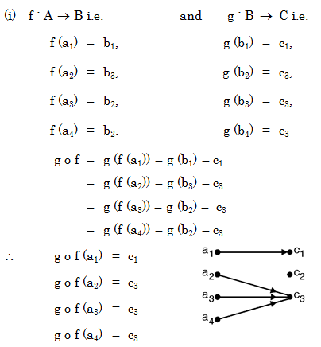

Slide 28
∴
For (h o g) o f
h o g
=h (g (b₁))
=
h (c₁)=d₁
=h (g (b₂ ))
=
h (c₃)=d₃
=h (g (b₃))
=
h (c₃)=d₃
(ii) h o (g o f)
= h (g o f (a₁))
=
=
h (c₁) d₁.
= h (g (b₄))
=
h (c₃)=d₃
h o g (b₁) | = | d₁
h o g (b₂) | = | d₃
h o g (b₃) | = | d₃
h o g (b₄) | = | d₃
(h o g ) o f = |  | (h o g) (f (a₁))
= |  | hog (b₁)
= |  | d₁
= |  | (h o g) (f (a₂))
= |  | hog (b₃)
= |  | d₃
= |  | (h o g) (f (a₃))
= |  | hog (b₂)
= |  | d₃
= |  | (h o g) (f (a₄))
= |  | hog (b₂)
= |  | d₃
=h (g o f (a₂))
=
=
h (c₃) d₃.
=h (g o f (a₃))
=
=
h (c₃) d₃.
=h (g o f (a₄))
=
=
h (c₃)
d₃.
28

Slide 29
Q. 3 : Consider the above function f (x) = 2x – 3. Find a formula for the composition functions (i) f² = f o f and (ii) f³ = f o f o f .
Soln. :
(i) | (f o f) (x) | = | f (f (x))
= |  | f (2x – 3)
= |  | 2 (2x – 3) – 3
= |  | 4x – 6 – 3
= |  | 4x – 9
(ii) (f o f o f) (x) |  | = f (f (f (x)))
= |  | f (f (2x – 3)) = f (4x –9)
= |  | 2 (4x – 9) – 3
= |  | 8x – 18 – 3
= |  | 8x – 21
29

Slide 30
IDENTITY FUNCTION
Let A be a non-empty set. Then we can always define a function
f : A → A (i. e. B = A) as f (a) = a for all a ∈ A
f is called the Identify function on A and is denoted by I_{A}.
I_{A} = {(a,a) | a ∈ A } Example :
Let A = { 1, 2, 3 } and f : A → A is identify function since
f (1) =1
f (2) =2
f (3) =3
30

Slide 31
INVERSE FUNCTIONS
Let f : A → B, be function, then
f ^{–1} : B → A is called the inverse mapping of f
f ^{–1} is the set defined as
_{f} –1
= {(b, a) | (a, b) ∈ f }.
A function f for which f ^{–1} exists is called invertible. Let A = { 1, 2, 3 } and f be the function defined on A
such that f(1) = 2, f (2) = 3, f(3) = 1. Then f^{–1} : A →
A is defined by
f ^{–1} (1)={ 3 }.
f ^{–1} (3)={ 2 }.
f ^{–1} (2)={ 1 }.
f ^{–1} ={(1, 3) (3, 2), (2, 1)}.
31

Slide 32
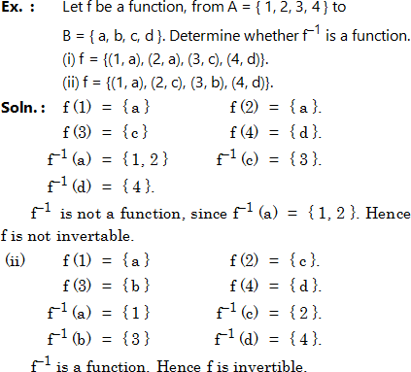

Slide 33
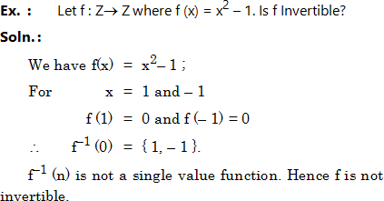

Slide 34
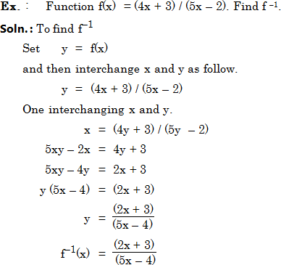

Slide 35
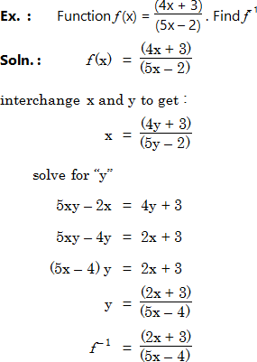

Slide 36
Steps
Set y = f ( x ) Interchange x and y Solve for y which is f⁻¹(x)
1) f(x) =1 / ( x - 2 )
2) f (x) = (x + 1 ) / x
3) f(x)= x ³ + 2
4) f(x)= 5 x – 7
5)f(x)= 8 / ( 9 – 3 x )
6)f(x)= ( 4 x + 3 ) / ( 5 x – 2 )
7) f(x)=(7 + 4 x ) / ( 6 – 5 x )

Slide 37

PIGEONHOLE PRINCIPLE
If n pigeons are assigned to m pigeonholes, and m < n, then at least one pigeonhole contains two or more pigeons.

Slide 38
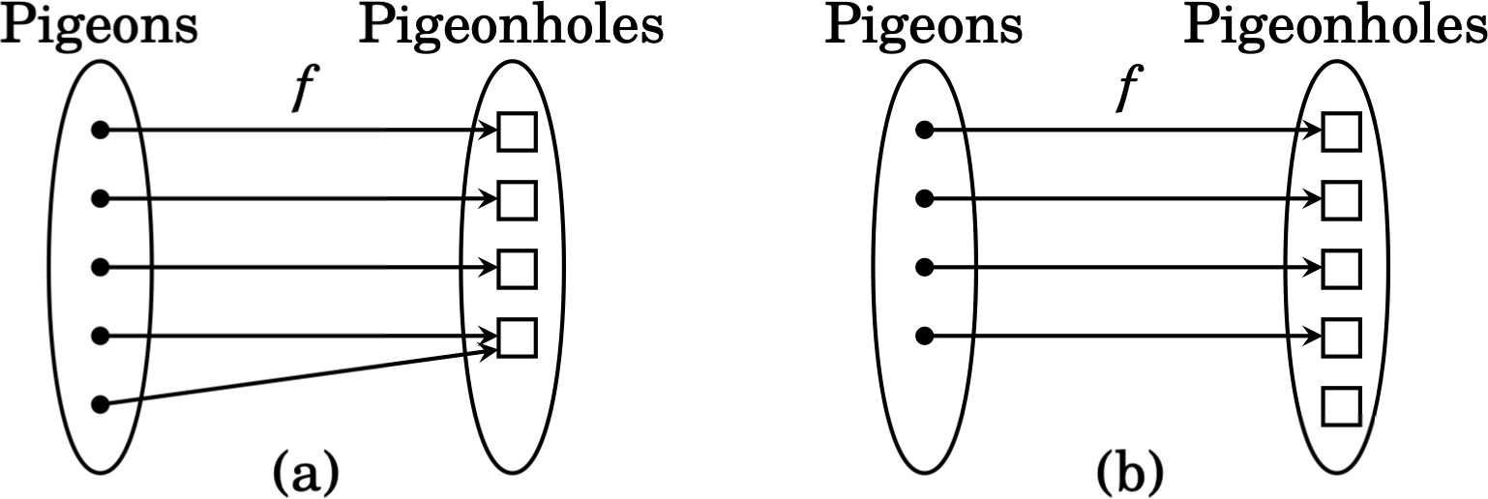
THE PIGEONHOLE PRINCIPLE (FUNCTION
VERSION)
Suppose A and B are finite sets and f:A→B
If |A|>|B|then f is not injective.
If |A|<|B|, then f is not surjective.
is any function.

Slide 39
THE EXTENDED PIGEONHOLE PRINCIPLE
If there are m pigeonholes and more than 2m pigeons, then three or more pigeons will have to be assigned to at least one of the pigeonholes.
If n and m are positive integers, then ⎣ n / m ⎦ stands for the largest integer less than or equal to the rational number n/m. Thus ⎣ 3/2 ⎦ is 1, ⎣ 9/4 ⎦ is 2 and ⎣ 6/3 ⎦ is 2.
Theorem : (The extended pigeonhole principle)
If n pigeons are assigned to m pigeonholes, then one of the pigeonholes must obtain at least
⎣ (n – 1) / m ⎦ + 1 pigeons.

Slide 40
PIGEONHOLE PRINCIPLE
Ex. 1 : If eight people are chosen in anyway from some group, at least two of them will have been born on the same day of the week.
Soln. : Here each person (pigeon) is assigned to the day of the week (pigeonhole) on which he or she was born. Since there are eight people and only seven days of the week, the pigeon hole principle tells us that at least two people must be assigned to the same day of the
week.
40

Slide 41
Ex. 2 : Show that if any five numbers from 1 to 8 are chosen, then two of them will add upto 9.
Soln. : Construct four different sets, each containing two numbers that add up to 9 as follows
: A₁={ 1, 8 }, A₂={ 2, 7 }, A₃={ 3, 6 }, A₄ ={ 4, 5 }
Each of the five numbers chosen must belong to one of these sets. Since there are only four sets, the pigeonhole principle tells us that two of the chosen numbers belong to the same set. These numbers add upto 9.

Slide 42
Ex. 3 : Show that if any 30 people are selected, then we may choose a subset at 5 so that all 5 were born on the same day of the week.
Soln. : Assign each person to the day of the week on which she or he was born. Then 30 pigeons are being assigned to 7 pigeonholes. By the extended pigeonhole principle with n = 30 and m = 7, at least
⎣ (30 – 1) / 7 ⎦ + 1 = 5 of the people must have been born on the same day of the week.

Slide 43
Ex. 4 : Show that if 30 dictionaries in a library contain a total of 61,327 pages, then one of the dictionaries must have at least 2045 pages.
Soln. : Let the pages be the pigeons and the dictionaries the pigeonholes. Assign each page to the dictionary in which it appears. Then by the extended pigeonhole principle, one dictionary must contain at least
⎣ 61, 326 / 30 ⎦ + 1 = 2045 pages.

Slide 44
Ex. 5 : Six friends discover that they have total of Rs. 2161. with them on a trip to the movies. Show that one or more of them must have at least Rs. 361.
Soln. : Let the rupees be the pigeons and the number of friends is number of pigeonholes. Then by the extended pigeonhole principle one friend must have at least
⎣ 2160 / 6 ⎦ + 1 or 361 rupees.

Slide 45
Ex. 6 : Show that if seven numbers from 1 to 12 are chosen, then 2 of them will add upto 13.
Soln. : Construct 6 different sets each containing two numbers that add upto 13 as follows.
A₁ | = | { 1, 12 }, | A₂ | = | { 8, 5 },
A₃ | = | { 7, 6 }, | A₄ | = | { 11, 2 },
A₅ | = | { 9, 4 }, | A₆ | = | { 10, 3 }.
Each of the seven numbers chosen must belong to one of the sets. Since there are only 6 sets, the pigeonhole principle tells us that two of the chosen numbers belong to the same set. These numbers add upto 13.
45

Slide 46
Ex. 7 : Show that 7 colors are used to paint 50 bicycles, at least 8 bicycles will be of same color.
Soln. : If n pigeons are assigned to m pigeonholes, and m < n, then at least one pigeonhole contains two or more pigeons.
By the extended pigeonhole principle at least
⎣ (50 – 1) / 7 ⎦ + 1 = 8 will be of the same color.
46

Slide 47
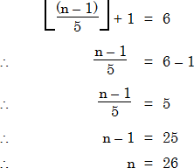
Ex. 8 : What is the minimum number of students required in a discrete structures class to be sure that at least six will receive the same grade, if there are five possible grades A, B, C, D, E
Soln. : By extended pigeon hole principle
26 Students are required in a discrete structures class.
47

